Slide 1
Proposal Writing

Slide 2
What is a Proposal?
Proposal is a formal written document, used in intra/inter departmental communication for seeking permission to make a purchase, undertake a project, develop additional infrastructure or materialise a product or write a paper etc. So, the proposal is a formal way of putting forth a novel idea and asking for action in that direction to materialise it.
The proposal outlines the plan of the implementing organization about the project, giving extensive information about the intention, for implementing it, the ways to manage it and the results to be delivered from it.
A proposal is a request for financial assistance to implement a project. Funding is sought, in whole or in part, from government funding agencies, charitable foundations, businesses, individuals, and other sources

Slide 3
Course Context
Proposal writing is a skill and requires considerable
knowledge in many disciplines.
If you do not have proposal writing skills,
your organization will not obtain the funding
required to carryout its projects
These materials will help you identify issues
relevant to your proposal

Slide 4
Course Context
Elements of effective proposal writing include:
Proper formatting
Content development
Satisfying program criteria
Demonstrating economic and social benefits
Addressing funding agency requirements
Demonstrating the sustainability of the project’s output
Selecting qualified consultants
Monitoring and evaluation provisions
Proposal follow up
Proper referencing of other documentation and
other sources of information used in preparing the
proposal

Slide 5
Course Context
Your proposal should demonstrate that your project will:
Provide economic benefit to an area or a community
Have a high probability of success
Address a strategic priority
Demonstrate need for financial assistance
Be economically viable
Have stakeholder support
Be consistent with development strategies

Slide 6
Course Context
Strategic Planning
Proposal Writing
Project Management

Slide 7
Types of Proposal
Solicited & Unsolicited.
The solicited proposal usually begins with a request for a proposal. Many companies will use a request for a proposal template to give potential suppliers details of what they are looking for in a bid. It will usually give a timeline of when items are due and what they are looking for in the document.

Slide 8
The unsolicited proposal is initiated by the person or organization who writes it. The writer/ organization usually submits it because they have an idea they want to put forth or they want to sell something.

Slide 9
Format a proposal
Introduction: This is a very general section which needs to be started in a very dramatic fashion to grab the attention of the reader. It established the agreement about the issue and begin to set the tone for the next section.
Purpose: Define the problem/issue to be solved. This need to be stated in a clear and concise manner to convince the reader that your proposal is a necessary one that needs immediate attention.

Slide 10
Justification: Give reasons for the need to solve the problem.
Background: What has already been done? What solutions are currently available? Include a literature review for an academic proposal.
Detailed Plan: Introduce your solution, including procedures, and materials. Add costs and time when necessary.

Slide 11
Argument: Justify your solution and method. Explain why your solution is a good one.
Executive summary/ Conclusion: Recommend any future action. It sums up the major points from the document to create a wholistic impact on the reader.
Reference: list of material referred to prepare the proposal

Slide 12
Funding Program Criteria
It is important to write a proposal which attracts the required funding. You must clearly understand the program requirements and ensure they are addressed in the proposal.
Funding programs differ with respect to
The funding cap (percentage of funding provided)
Eligible costs
Eligible applicants (profit/not-for-profit)
Eligible sectors (tourism, agriculture, forestry)
Project location
Information required

Slide 13
Sample Proposal
To: Rev. Mark Smith
From: Nicole Johnson
Date: March 10, 2020
Subject: A proposal to purchase new Electronics pencil sharpeners for the classrooms of St. Mary's School

Slide 14
Purpose of the Proposal: I am writing this letter to propose a solution to a recurring problem at St. Mary's School. The problem is that the pencil sharpeners in the classrooms are very old and do not work effectively anymore. Students and teachers continually become frustrated because it is difficult to sharpen a pencil with the current sharpeners, and pencils that are sharp are crucial for effective learning.

Slide 15
Statement of Problem: I suggest that we order new pencil sharpeners for each classroom so that the students will have pencils that work well and will therefore be able to write without the frustration of worn-down pencil points.

Slide 16
Justification: There are 217 students enrolled in kindergarten through 8th grade at St. Mary's School. These students occupy 12 classrooms each day. None of these classrooms has a pencil sharpener that works well; it takes several minutes to sharpen just one pencil.

Slide 17
Cont..
This means that if all of the students need to sharpen their pencils once a day (depending on how much writing is being done, a pencil may need sharpened more than once a day), it could take an average of 30 minutes to sharpen them all before the students can sit down to their desks and start learning the day's lessons.

Slide 18
Background Information: Thirty minutes of time spent sharpening pencils takes away a great deal from instructional time. However, not all the students need to sharpen their pencils at the same time. This need arises at various times throughout the day, often at the beginning of a test or a new lesson

Slide 19
. Because of the length of time it takes to sharpen a pencil, the teachers have continuous interruptions in their lessons throughout the day. Almost everything done in a classroom requires a pencil, especially as students get older, and it is difficult to get anything done without this basic tool.

Slide 20
The current pencil sharpeners have been in the classrooms as long as Mrs. Morris has taught here, and that is over 30 years. They do not work well because they have been in use for so long. Even after sharpening for several minutes, the pencil points are still not as sharp as they should be, and the points break off easily, causing them to need to be sharpened yet again.

Slide 21
Proposed Solution: I propose that we purchase electric pencil sharpeners for each classroom. These work quickly and effectively, and take only a few seconds to sharpen a pencil. Office World carries several pencil sharpeners designed specifically for schools and the high volume of use sharpeners get in classrooms

Slide 22
Proposed Costs: The Used-All-Day Pro Student Electric Pencil Sharpeners cost $42.29 each. However, Office World gives a discount if purchasing 10 or more, reducing the cost to $35.29 each. Because we are a member of the Office World Schools frequent shopper program, we will receive 2% of our purchase back at the end of the school year. This makes the total cost of the purchase $415.01.

Slide 23
Conclusion: I believe purchasing new electric pencil sharpeners for each classroom would be of tremendous benefit to St. Mary's School. It would put an end to the constant frustration of students never being able to find sharp pencils, and of losing instructional time because of the length of time it takes to use our current sharpeners.

Slide 24
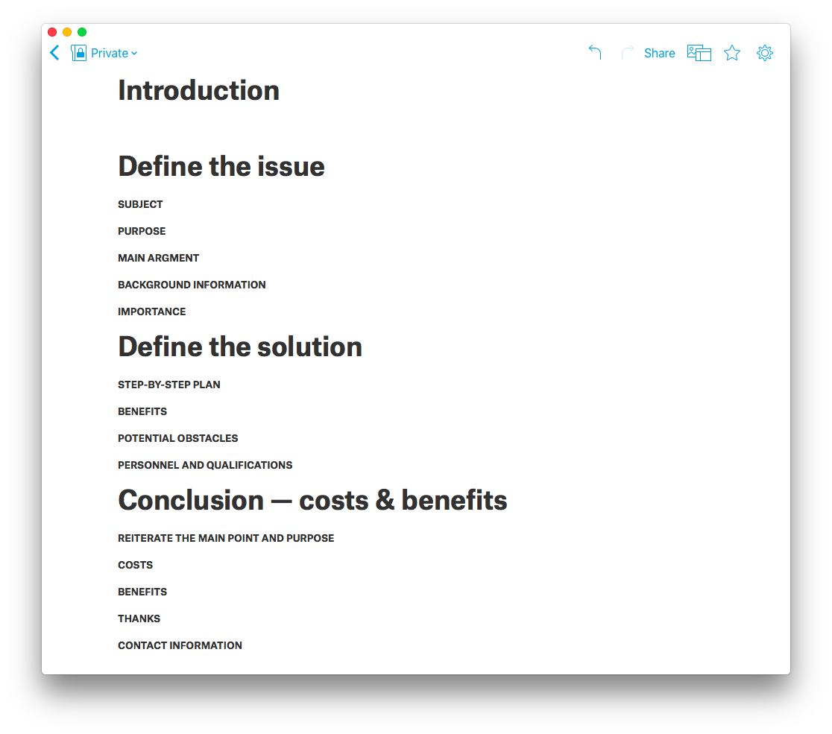

Slide 25
Exercises
Task 1
The central library of your university has a seating capacity of one thousand in its reading room. With the steep rise in the number of admission of students in your university, many students in the week days do not get a seat in the study room to have access to e-resources of the library. You propose to open another library in the premises of your department, as an extension of the central library, to avoid congestion. As the secretary of your department write a proposal highlighting the importance of the separate library, the cost and human resource, infrastructure required for the same. The proposal will be submitted to the Vice-chancellor.
Task 2
You have developed a new idea in the field of your study that needs rapid prototyping. For this purpose, you need a seed grant of at least 2lakh rupees. Write a proposal to the Director of your institute for the sanction of the amount for the materialization of your scientific innovation.

